Slide 1

SHELTER
APP THAT CATERS TO HUMANITY

Slide 2
CODE VAGABONDS
SIDDHARTH SINGH(LEADER)
HRISHIT PRASAD BISWAS
RAYAK SIL
NEELANJAN GHOSH
Theme domain - Healthcare

Slide 3
Problem Statement
Due to COVID 19 a huge number of people in the country are on the streets now without shelter and food.How can we use technology to solve this problem?

Slide 4
Solution
User Base
01
This solution is intended to help people who have been stuck far away from their homes due to the sudden implementation of a nationwide lockdown.
02
The users of the app will be our own citizens who have a property that is lying empty at this time. These are the people willing to come forward to help other distressed men in this unfortunate circumstance.
03
This app will also be used by police and local authorities which will help in getting the stranded people a shelter. It will also be used by administrators who will verify the property ownership details of a place.

Slide 5
Solution
Benefits of the User Base
01
This app is intended to provide a respite to all the people stuck in various parts of the country by providing them with shelter and food.
02
The people who come forward to help the victims of lockdown will be rewarded by tax exemption (based on the no of people they accommodate) once the lockdown is over.
03
This app will help the police to find a home for these homeless victims. Since these people are now currently living in large groups mainly in mosques and temples, this app will help disperse the crowd and hence preventing the rapid spread of Covid-19.

Slide 6
Solution
Impact
01
According to popular metrics, there are 40 million migrant workers in India. Most of them belong to the economically weaker parts of the society who uses cheap forms of transport like railways to travel from one place to the other.
02
Due to sudden implementation of a nationwide lockdown such people were left stranded at their workplace, and later started seeking a shelter in public places like mosques, railway stations and temples.
03
Our solution will help these affected people to find some relief and will also help prevent the spread of Covid-19, which can spread like wildfire from the mass gathering of such people.

Slide 7
Solution
Frameworks/Technologies Used
01
UI Design - Adobe XD Adobe XD is the de facto no 1. Application when it comes to designing an app. It allows an user to create beautiful UI with ease.
02
Front End -Java Java is the default programming language used for android app development. It is faster and easier then other android frameworks.
03
Database - MySql and Parse Server API It is easy to use and is highly flexible. Also there is no data leakage. However, the most important feature is that the data is visible in the form of User Ids and Tables.

Slide 8
Solution
Effectiveness of the Solution:
01
This solution provides local agencies to not only help people find a shelter but to also distribute food among the shelters.
02
This will not only help provide them relief, but also help prevent the spread o the disease by dispersing the crowd.
03
The implementation would not be that hard as local police are most likely aware of the location of those stranded in their area. Also, many people are likely to come out forward to help as they are already helping the society by donating huge sums of money to the relief fund.
Since funds have been allocated by our government for food supplies in the form of rations. These people can thus be provided with prepared food using the same fund and could be distributed by the police as they have the details of the distribution of people in their local shelters.
04

Slide 9
Solution
Business Model and Future use cases
01
In the current scenario of global pandemic, the app will be completely free to use.
02
After things return back to their normal state, this app could be re designed and re-branded as an app to help find backpackers find a cheap place to crash in for the night. Revenue would then be generated by placing ads and charging a small fee in every booking done through the app.
03
Also the current version of the app can be used to connect various victims and NGOs through local people, local authorities and the police.

Slide 10
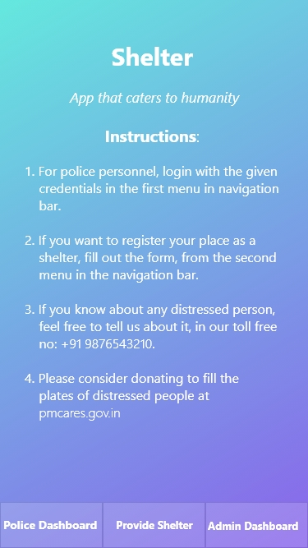
Demonstration : SHELTER
An app that caters to Humanity : Finding shelters for the stranded
Home Screen:
In the home screen, we are greeted by a guide that shows how to navigate through the app.
It also contains links to donate to the pmcares.gov.in website, which will be used to fill the plates of the distressed.
It also gave a toll-free no to contact if a person is aware of such a victim.

Slide 11
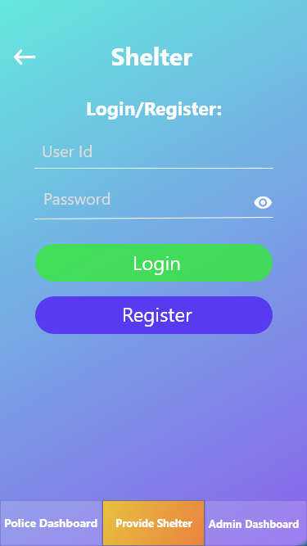
If this is the first time a user is logging into the website, he/she should apply for register, which opens the register page.
If the user’s registration has been completed, he/she can login to the app via the provided credentials.
Login Page for the User

Slide 12
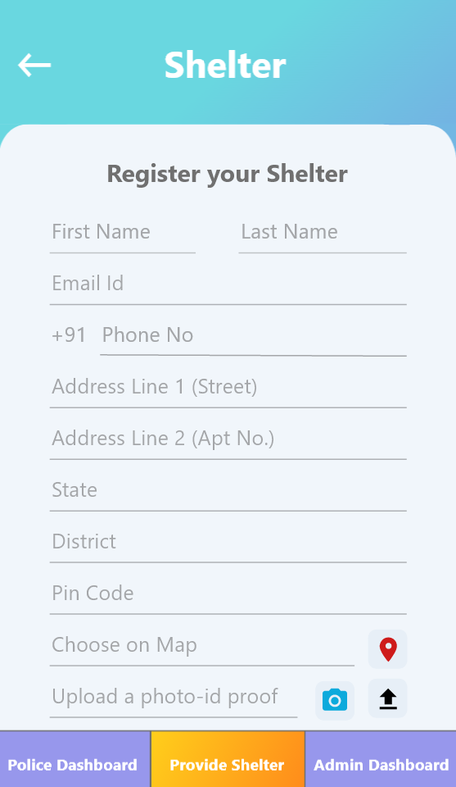
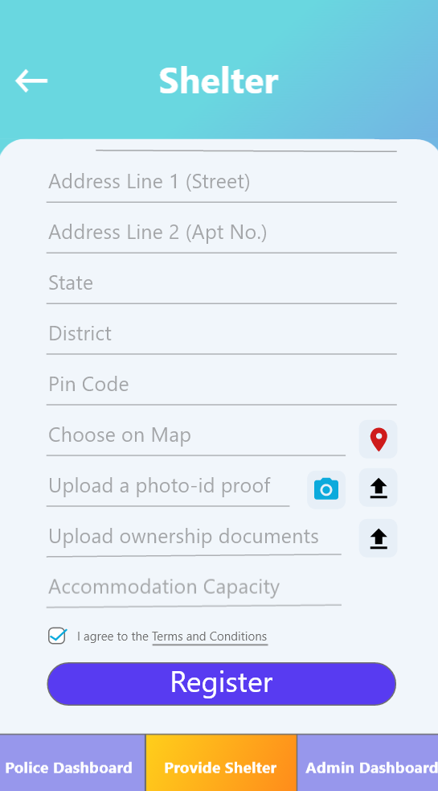
User User Registration Page
If the user has clicked on the register button in the homepage, he would be redirected to this form, where he can upload all the necessary details and click on the register button, and the user will then be redirected to the pending request page.

Slide 13
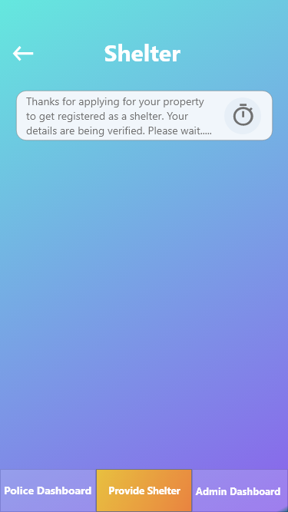
After submitting the form, the user will be redirected to this page.
For the time being, the details has been sent to the admins, for getting the information cross-verified.
On completion of cross verification, the user will get a mail and a notification regarding the status of the application.
The user will also get the login credentials if verified.
Confirmation Page

Slide 14
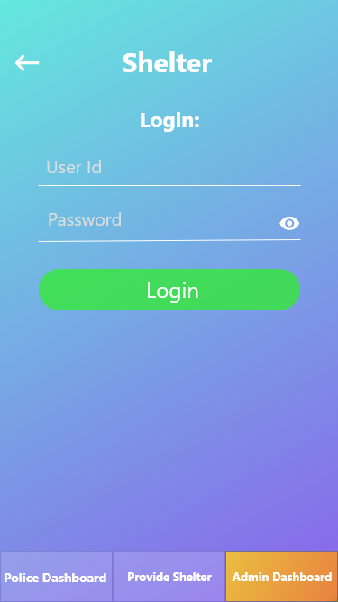
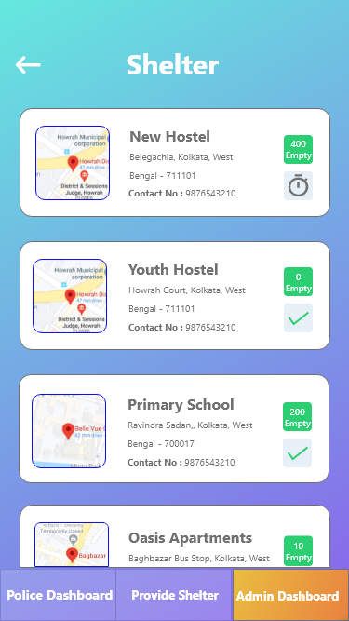
Admin login and dashboardPage
The admin has to login with the generated credentials.
After the user has submitted the registration form, it has come to the admin to get his information cross verified.
This page will also list previous forms submitted and their application status.
Clicking an entry will lead to the description page(next slide).

Slide 15
The admin has to login with the generated credentials.
After the user has submitted the registration form, it has come to the admin to get his information cross verified.
This page will also list previous forms submitted and their application status.
Clicking an entry will lead to the description page(next slide).
Admin login and dashboard

Slide 16
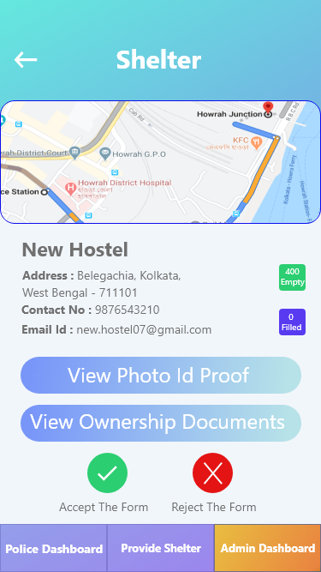
Here all the entered details available.
After cross verifying all the info, the admin must either reject or accept the form accordingly.
Property verification file

Slide 17
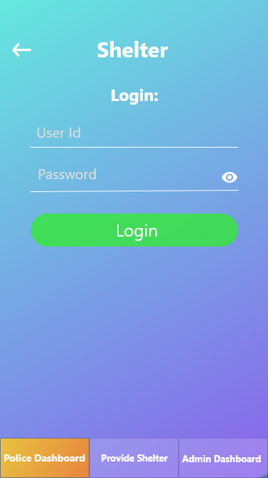
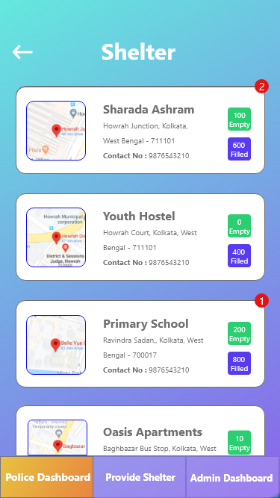
Police login and dashboard
Upon login, with the given credentials, the police will then be able to see all nearby shelters(verified by our admins) sorted according to our algorithm(refer to the flowchart).
On the list the police is able to see all the necessary contact details, map location, empty and filled spots.
The filled spots are shown because the police will be able to distribute food accordingly, to these shelters.

Slide 18
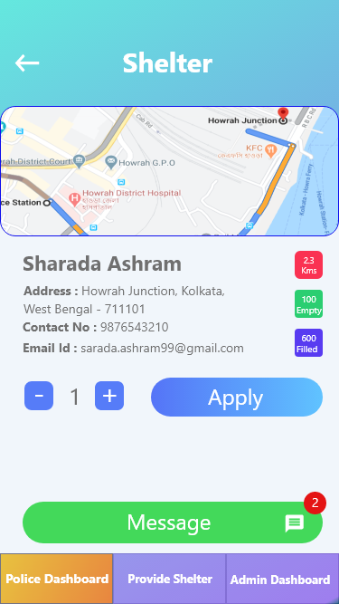
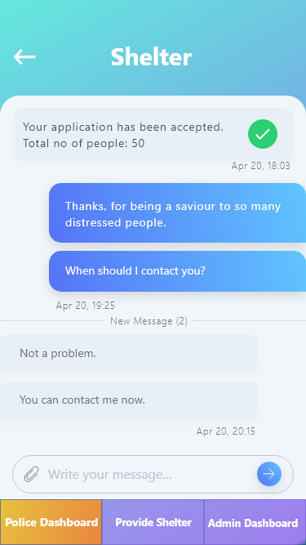
Shelter details and chat with owner
The police should now be able to apply for transfer of a no of distressed people, by choosing a no and then hitting the apply button.
On clicking the apply button, we send an automated message to the owner with an option to accept or reject the application.
He/She can also chat with the owner regarding the transfer of such people.

Slide 19
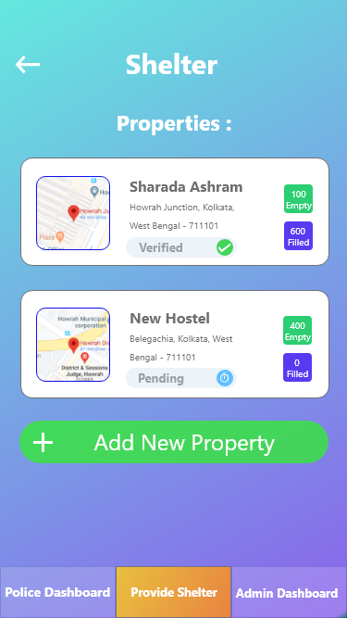
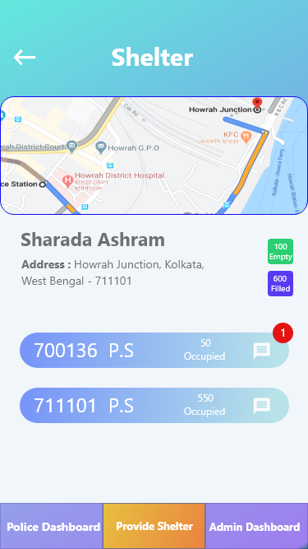
Owner Properties List and Dashboard
After successful registration of an user, he/she can login to his dashboard via the login credentials sent to his mail.
On login, the user will find the no of properties listed by him each of them, showing their verification status and a button to add more properties.
On clicking a particular property, its information will be displayed along with the requests by various police agencies.
On clicking on the list buttons, a chat window with the police will

Slide 20
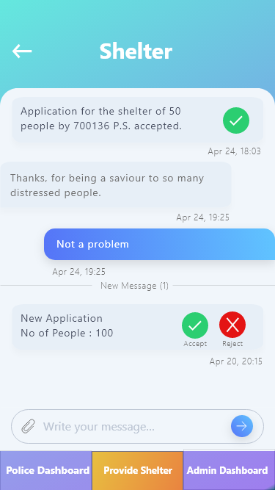
This is the chat screen with the police.
The user will be able to accept or reject the people transfer proposals made.
Owner Chat with Police

Slide 21
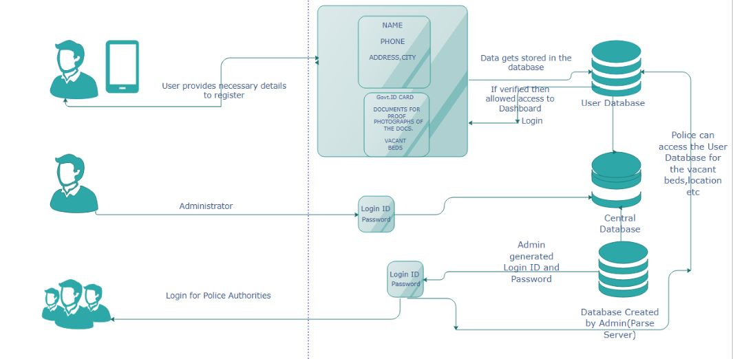
Architectural Design

Slide 22
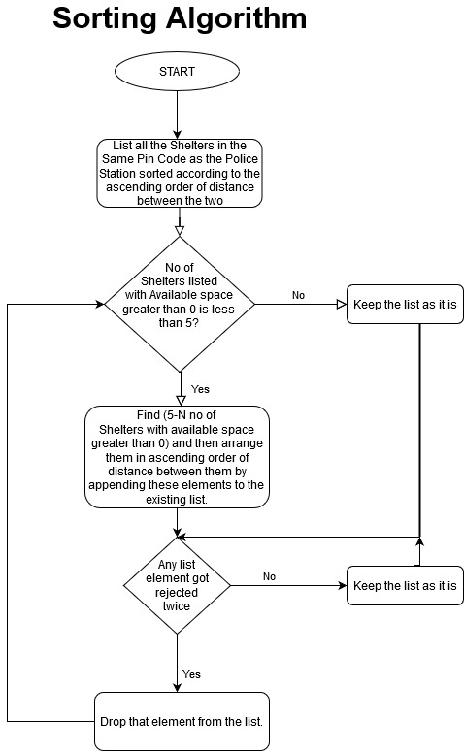
Flowchart for police dashboard Sorting Algorithm

Slide 23

Thank you!
Have a nice day!!!

